Slide 1


A Guide to Making Every Contact Count (MECC) e- Learning Programmes and Related Resources
Population Health and Prevention National Programmes

Slide 2
What is MECC?
MECC is an approach to behaviour change that uses the millions of day-to-day interactions that organisations and people have with other people to support them in making positive changes to their physical and mental health and wellbeing.
Drawing on behaviour change evidence, MECC maximises the opportunity within routine health and care interactions for a brief or very brief discussion on health or wellbeing factors to take place.
https://www.nice.org.uk/Guidance/PH49

Slide 3
What is MECC?
MECC enables the opportunistic delivery of consistent and concise healthy lifestyle information and enables individuals to engage in conversations about their health at scale across organisations and populations.
A MECC interaction takes a matter of minutes and is not intended to add to the busy workloads of health, care and the wider workforce staff, rather it is structured to fit into and complement existing professional clinical, care and social engagement approaches. Evidence suggests that the broad adoption of the MECC approach by people and organisations across health and care could potentially have a significant impact on the health of our population.

Slide 4


Proposed Target Audience
The point about MECC interventions is that they don’t need to be undertaken by a health professional. By developing some simple key communication skills and communicating evidence based healthy lifestyle messages – everyone can have a role to play.
MECC is about utilising those every day conversations with the public to make a difference.

Slide 5
Proposed Target Audience
Outlined below are some suggested examples of the target audience but not an exhaustive list: -
All the health and social care workforce across a wide range of settings and anyone working with the public
Administrative and support staff in health care across a range of settings such as primary care, acute and tertiary care
Undergraduate health care workforce in further and higher education settings as part of the curricula
Administrative and support staff in other public sector settings such as local authorities and the voluntary sector
Public health/health promotion staff across all sectors including local authorities, NHS and primary care
Social care workforce
All those working with the public in the charitable sector
All those that work on the wider determinants of health such as housing, education, work places and education settings.

Slide 6




Practical Resources
The following resources aim to support the implementation and evaluation of MECC activity and development of training tools:
MECC Consensus Statement (refreshed)
Implementation Guide
Training Quality Marker Checklist
Evaluation Framework
https://www.gov.uk/government/publications/making-every-contact-count-mecc-practical-resources
Notes:
These were developed from some of the work that was taking place in the regions – the Wessex implementation guide – evaluation from KSS work

Slide 7
MECC e-Learning Resources
The purpose of the E Learning resources are:
To provide a freely available and flexible approach to developing key skills, competence and confidence to deliver brief, opportunistic lifestyle advice as part of daily interventions with the public – where appropriate.
To support a consistent and quality assured approach to learning and skill development in this area – available to all levels of the workforce.
To provide opportunities for large scale workforce development approaches in this area.
The learning is specifically aimed at making sure that we all offer healthy conversations in all contacts with patients, clients and members of the public. However, the skills required for effective health conversations can be applied to the wider social determinants of health as well.
Healthy conversations can be used as a normal part of all our interactions at home, in the workplace and in the wider community.

Slide 8
How might the programmes be used?
As an introduction to basic behaviour change skills
To consolidate existing skills on behaviour change
As part of an organisation’s induction process, reflecting a commitment to promoting health and personal wellbeing
For personal professional development and to support an individual as a future MECC champion at home or in the workplace

Slide 9
HEE MECC Resources
The e-LfH platform now hosts two main MECC E learning programmes. Both are freely available and should be used per local learning needs. Both consist of more than one resource.
One set of resources has been developed by the West Midlands and the other by Wessex, Thames Valley, Kent, Surrey, Sussex.
If you work in the NHS, social care or local authority then you can access freely all the resources listed via the E Learning for Health platform.
At an individual level you can register for an E Learning for Health account at: www.e-lfh.org.uk
If you register with an account at e-LfH your learning will be registered, and you will be able to access a wide range of health e learning resources.

Slide 10
More About How to Access MECC E Learning Resources
Both are available on the E Learning for Health platform (e-LfH) and the National Learning Management System (NLMS) for the NHS workforce.
The E Learning for Health platform is available to health and social care staff with or without an NHS account.
Organisations – such as local authorities for example can integrate the MECC modules onto their own organisations learning management platform to monitor usage data. To integrate onto local LMS systems click here
For further information contact support@e-lfh.org.uk

Slide 11
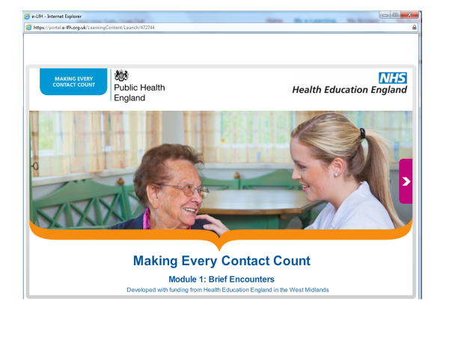
West Midlands Resources – a MECC Toolkit
Brief Encounters: e-learning session, suitable for all frontline staff, based on a simple Ask, Advise Assist conversation framework to enable all frontline staff to have brief conversations that raise awareness of wellbeing (and lifestyle behaviours), utilising holistic approaches and enabling lifestyle changes, and signpost to trusted sources of information and support.
Motivating Change: the focus is on the behaviour change model and person-centred conversation framework. The session is suitable for staff working with people who are either at high risk of lifestyle-related health conditions or already have one or more health conditions or who care for people with health conditions. This session also introduces a health-coaching conversation framework for learners supporting people to make and maintain their desired behaviour changes.
MECC Plus for Integrated Care: these additional resources support the workforce to implement MECC based on Integrated care principles and practice. They comprise case studies, PowerPoint and exemplar MECC pathways, illustrating how brief person-centred conversations can support the holistic assessment of a person’s needs as well as enable the person to make changes necessary to improve their self-care management. A MECC Plus Manual suggests bite-sized learning opportunities for managers and trainers to use with their teams. A MECC Plus Pocketbook provides an aide memoire for all frontline staff (available in West Midlands only).
Sally James (Public Health Workforce Lead, HEE Midlands & East) said:
It would be great if all new starters could do module one of the e-learning as part of their induction and all current staff do it as part of their annual mandatory training, to really embed the principles of public health and prevention
“
”

Slide 12
Wessex, Thames Valley, Kent, Surrey, Sussex Resources
This resource, composed of four e-learning sessions, is intended for anyone who has contact with people to make every contact count and develop public health knowledge. The package is part of a two-phase learning approach developed to ensure learners gain understanding and practical skills.
MECC approaches are a key enabler to supporting health improvement, prevention and reducing the health inequalities agenda.
MECC can be used at an individual level to affect change at community and population level.
Introduction to Making Every Contact Count – 20 minutes
Introduction to Skills – 20 minutes
Introduction to Lifestyle Topics – 20 minutes
Signposting and Your Organisation – 20 minutes

Slide 13
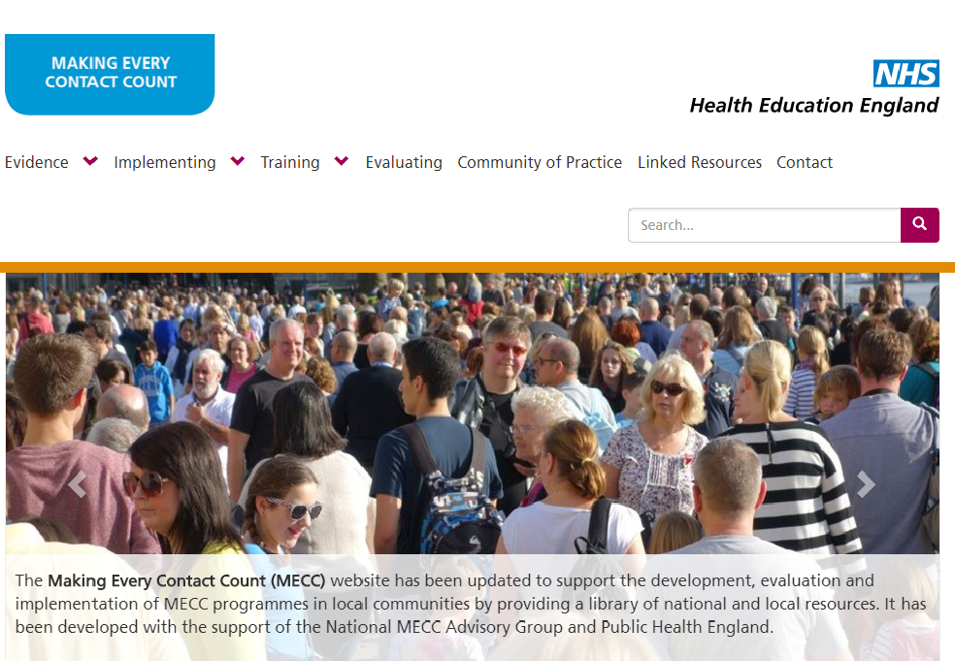

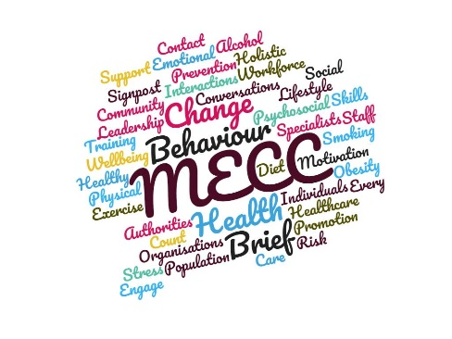
Related Useful Resources
The MECC Website provides resources and information to support people and organisations implementing MECC and has been developed with multi-agency input at local, regional and national level. The purpose of the site is to provide a free single point of information on a range of resources, case studies, policy guidance and associated national, regional and local approaches to MECC implementation and practice.
The website provides a useful starting point for any individual or organisation exploring MECC for the first time. The website is moderated by the National HEE Population Health and Prevention team. If you would like to share your work / contribute to the MECC website contact php@hee.nhs.uk
The MECC Community of Practice is an open Facebook group that provides an opportunity for informal peer led support and discussion on all matters associated with MECC work and practice. It provides a platform to network with others, and share useful information and resources.

Slide 14
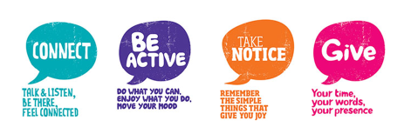
Five Ways to Wellbeing (E Learning Module)
The Five Ways to Wellbeing module has been added to the MECC programme on the e-Learning for Healthcare platform. The module introduces the concept of wellbeing and describes how the Five Ways to Wellbeing can be implemented in a variety of settings to promote it. The content was developed by Lancashire Care Foundation Trust and adapted by HEE to target a national audience and support the wider MECC campaign.
The ‘Five Ways to Wellbeing’ framework - a set of evidence-based actions to help improve people’s wellbeing - was developed by the New Economics Foundation (NEF) in 2008. These 5 actions are:
Give
Be active
Keep learning
Connect with the people around you
Take notice
To access the free MECC e-learning programme, including the recently added Five Ways to Wellbeing, click here

