Slide 1



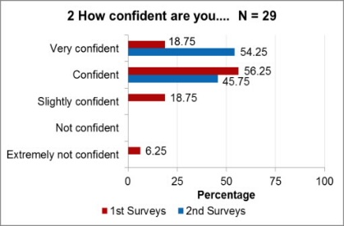
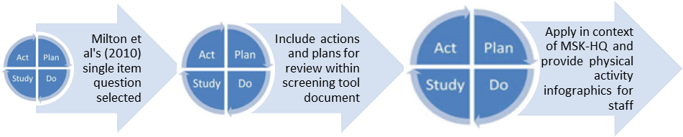
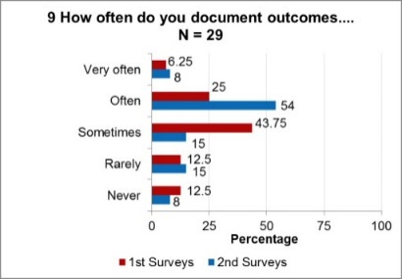
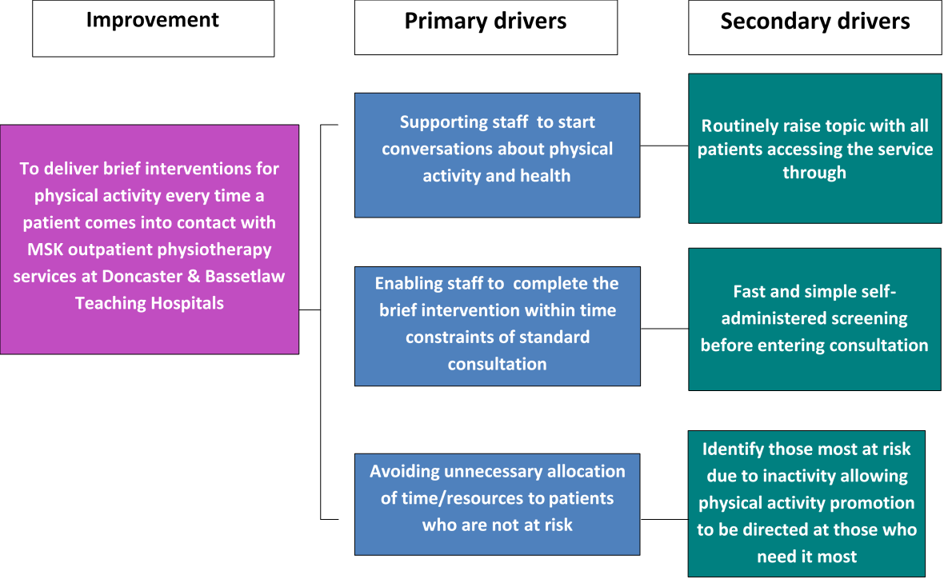

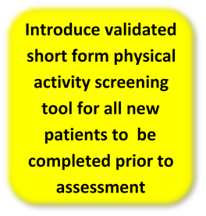
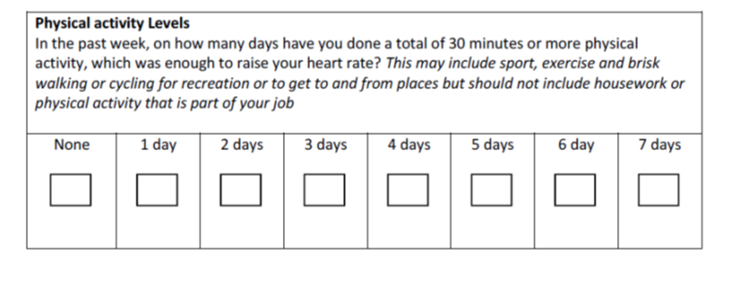

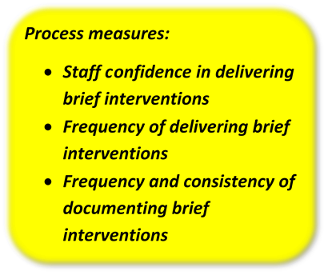

Making Every Contact Count
for physical activity in musculoskeletal outpatient physiotherapy
Jennifer Harris, Anna Lowe, Jane Cliff, Alex Thompson & Julie Bury
Background
Physical inactivity is a major risk factor for long-term disease and death¹
With only 52.6%² of adults meeting physical activity recommendations , Doncaster is one of the most inactive regions in England
A large proportions of patients accessing outpatient physiotherapy services are classified as overweight or obese and are considered physically inactive³
By encouraging and supporting healthy choices each time they interact with a patient, physiotherapists have the opportunity to positively affect the health and well-being of local people
Methods
Process measure data collected via Survey Monkey pre and post-implementation of change
Implement changes according to 3 phases of Plan, Do , Study, Act cycles;
One physio for one clinic
All physios at one hospital site for one clinic
All physios at all hospital sites for one week
Results
What we learnt
A targeted approach to identifying inactive people accessing MSK physio supports physiotherapy staff to feel more confident to identify patients at risk due to inactivity (25% increase in staff feeling confident or very confident) and to document outcomes of these conversations more often (31% increase in staff documenting often or very often)
Physical activity screening can be incorporated into musculoskeletal health outcome measurement as part of routine practice facilitating evaluation of brief interventions
Further efforts are required to facilitate fast, simple and accurate signposting to local services, written information on health benefits to patients and support documentation
Next steps
Evaluate implementation of MSK-HQ
Incorporate physical activity screening, documentation and signposting within MECC service pathway (Way Forward Doncaster)
How confident are you to identify patients attending physiotherapy who are at risk due to inactivity?
The question for patients to complete re activity levels gives a really good starting point for discussions to be had I think
The questionnaire for patient to complete was a good way to quickly identify their level of activity
How often do you document outcomes of brief interventions for physical activity in a patients physiotherapy records?
The change
The following validated screening tool⁴ was completed by all new patients accessing MSK physiotherapy;
Participants
Changes were implemented across four hospital sites by all qualified physiotherapy staff (A4C bands 5-8) covering MSK outpatients, rehabilitation and clinical assessment and triage services. All participants were invited to complete process measure surveys before and after changes took place.
16 (32%) staff completed the baseline survey and 13 (26%) completed the post-implementation survey
Purpose
To establish a suitable targeted approach to identifying inactive people accessing musculoskeletal (MSK) outpatient physiotherapy services at Doncaster & Bassetlaw Teaching Hospitals NHS Foundation Trust in order to facilitate brief interventions for physical activity and make every contact count.
References
1. World Health Organization, Global health risks: mortality and burden of disease attributable to selected major risks. 2009, WHO: Geneva.
2. Public Health England. Physical activity public health profiles. 2016 22/06/2017]; Available from: http://fingertips.phe.org.uk/profile/physical-activity.
3. McPhail SM, Schippers M, Marshall AL, Waite M, Kuipers P. Perceived barriers and facilitators to increasing physical activity among people with musculoskeletal disorders: a qualitative investigation to inform intervention development. Clinical Interventions in Aging. 2014;9:2113-2122. doi:10.2147/CIA.S72731.
4. Milton K, Bull FC, Bauman A Reliability and validity testing of a single-item physical activity measure British Journal of Sports Medicine Published Online First: 19 May 2010. doi: 10.1136/bjsm.2009.068395
Acknowledgements
Thanks to all the staff, patients and managers who participated in and supported this study
Thanks also to NIHR CLAHRC Y&H TK2A team who inspired this project in order to support co-designed MECC service pathway ‘Way Forward Doncaster’
Further question? Please contact: Jennifer Harris, Senior Physiotherapist, Doncaster Royal Infirmary , Armthorpe Road, Doncaster, DN2 5LT,  01302 642636  jenniferharris@nhs.net

