Slide 1

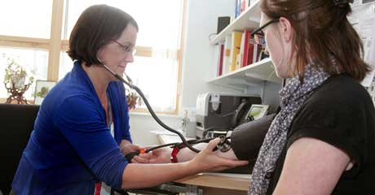

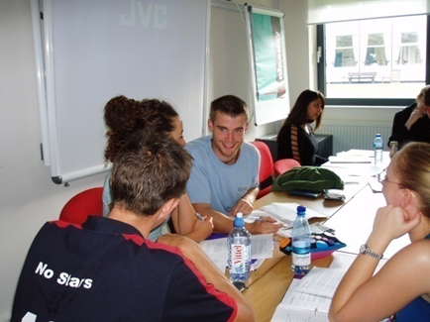
Skilling Up Medical Students to Promote Health Behaviour Change and Deliver Brief Interventions
Clare Blackburn¹, Wendy Robertson¹, Kate Owen¹, Vinod Patel¹, Sarah Hauxwell¹, Harbinder Sandhu¹, Shilpa Patel¹,Jane Wright²
¹ Warwick Medical School, University of Warwick, Coventry CV4 7AL; ² George Eliot Hospital NHS Trust
Introduction
Skilling up doctors to help patients adopt healthier lifestyles is key to reducing preventable chronic diseases and improving health. The increase in preventable conditions and persistence of health inequalities are among the greatest challenges for patients and the NHS. Doctors and other health care professionals are expected to use every contact to help people lead healthier, longer lives.
What are we doing?
At Warwick Medical School we are skilling up our graduate entry medical students, from early in Year 1 to promote health behaviour change and deliver brief interventions.
By the time students enter their first sustained period of clinically based learning in Year 2 they are trained to:
Engage in health behaviour change conversations
Carry out very brief interventions on smoking and alcohol
Deliver these to patients, under supervision, in the clinical setting
Year 1
Theories of health behaviour change, health promotion and health inequality
Identifying readiness to change (with peers and simulated patients)
Practicing taking lifestyle histories and initiating behaviour change conversations (peers)
‘Making Every Contact Count’ training
Early Year 2
Online training courses:
The Very Brief Advice on Smoking course^{1:} includes core NICE competencies on helping people to quit
The Alcohol Identification and Brief Advice course² – learn to identify patients’ risk of developing alcohol related problems and to deliver a brief intervention
Practicing smoking and alcohol brief interventions with peers
¹ www.elearning.ncsct.co.uk/vba-launch
^{2.} www.alcohollearningcentre.org.uk
Mid Year 2 onwards
Students practice the skills in the clinical setting under supervision
Skills to be assessed using OSCEs
Further teaching and learning on helping patients self-manage chronic conditions
Evaluation
Students have given positive feedback on the learning so far.
By late year 2, only a few students have tried out the skills in practice
Need to remind clinical staff to observe students delivering interventions
Consider adding to clinical skills log
More evaluation data being collected at end of Year 2
The programme was developed collaboratively by the public health, psychology, clinical skills and GP teaching teams
in conjunction with a NHS health promotion specialist.
Contact: Clare Blackburn: c.m.blackburn@warwick.ac.uk or Wendy Robertson: w.robertson@warwick.ac.uk or Sarah Hauxwell: s.hauxwell@warwick.ac.uk

