Slide 1
Making Every Contact Count Orthoptic Case Studies

Slide 2
Case Study 1 - Luton
Caroline Doherty
Orthoptic Team Leader
SEPT Community Health Services, Bedfordshire
Eye Clinic, Liverpool Road Health Centre
9 Mersey Place, Liverpool Road
Luton, LU1 1HH
Tel: 01582 708155/4/3 (4155/4/3)

Slide 3
Case Study 1 – The local picture
Central Bedfordshire
1 in 7 children are obese by 10-11 years of age.
24.8% or 49,000 adults are estimated to be obese.
17.5% of the population still smoke.
20% of adults aged 65 years and over were estimated to be heavy drinkers in 2008.
Drinking to harmful levels is an issue with the rates of admissions to hospital as a result of alcohol are rising.
Bedford Borough
1 in 5 children are obese by 10-11 years of age.
22.7% or 27,000 adults are estimated to be obese.
19.6% of the population still smoke.
There has been a marked increase in the amount of alcohol consumed by middle and older age groups. Approximately a third of older people with drinking problems develop them for the first time later in life.
Notes:
What do the group think are the issues which affect their service users / clients? Ask for a few suggestions before revealing the answers.
Additionally
In the most deprived areas of Bedfordshire the percentage of the population who smoke is 22.4%
Central Beds:
In 2009/10 there were over 4,000 admissions to hospital as a result of alcohol related harm, a 13% increase compared with the previous year.
Only 11% of adults in Central Bedfordshire are physically active enough to benefit their health. There is considerable evidence to show that increasing levels of physical activity benefits both physical and mental health. (from draft JSNA Exec summary 2012)
There is low up-take of seasonal flu vaccines from pregnant women
Due to the general rural nature of Central Bedfordshire, there are relatively large areas where the availability of public transport is limited leading to poor accessibility to services and an increasing need to use cars rather than more sustainable or healthier forms of transport.
Bedford Borough
In 2009 an estimated 22.5% of people in Bedford Borough were from ethnic minority communities compared to 17% in England. The largest of these groups are Asian (9.1%); White Other (6.5%); Black (3.4%) and Mixed (2.3%). The black and ethnic minority (BME) populations have a higher proportion in younger age groups
Only 13% of adults in Bedford Borough are physically active enough to benefit their health. There is considerable evidence to show that increasing levels of physical activity benefits both physical and mental health.
Teenage pregnancy rates have plateaued while nationally they are reducing, and they remain above the national average.
There is a significant and growing gap in life expectancy within Bedford Borough: the gap between the most affluent and most deprived areas is on average 9.1 years for women and 11.3 years for men.

Slide 4
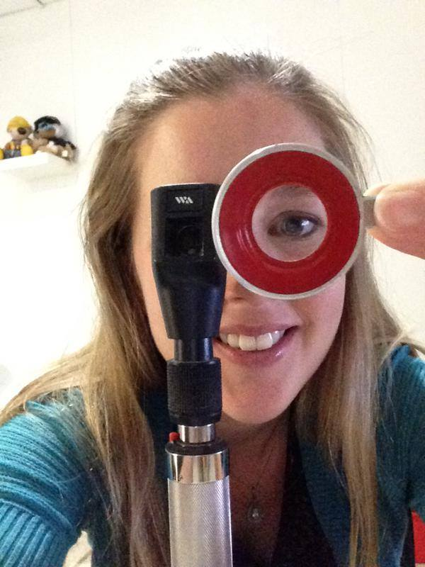
Case Study 1 – Reactions from the Orthoptic Team
“It was quite hard work to ask a lot of questions to the parents, and word them in a way that seemed relevant to an eye appointment – but we did it!
Also we see patients in 20 minute slots and need to use our time wisely for maximum benefit for an eye appointment. We did refer six patients to smoking cessation over the year using MECC.”

Slide 5
Case Study 2 - Manchester
Nicola Morris
Advanced Orthoptist
Manchester Royal Eye Hospital
Central Manchester University Hospitals NHS Foundation Trust
Oxford Road
Manchester
M13 9WL

Slide 6
Case Study 2 - Help for weight-related eye conditions from the orthoptic team
We are providing more information for patients where weight loss is concerned and hoping to have the involvement of a dietician/weight loss nurse within Idiopathic Intracranial Hypertension (IIH) clinics.
One example is from my colleague, Esther Loxley, who treated a diabetic/obese patient who developed a 6th nerve palsy. She took the opportunity to explain to him the possible reasons for the problem including the fact that he was obese.
As a result of this, the patient took on board her advice. At his follow up appointment his nerve palsy had started to recover and he had lost 2 stone in weight! The patient has provided a patient story for us and he has now fully recovered.

Slide 7
Case Study 3
Lorraine Floyd
Orthoptist
Bridgend Eye Unit
Wales

Slide 8
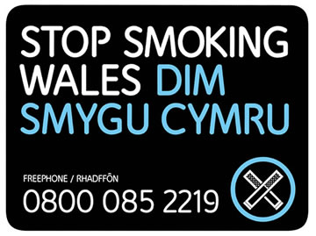
Case Study 3
We have had training from Stop Smoking Wales and a section on our Orthoptic proforma where we tick “Smoker” or “Non smoker” and advice offered /referral to the cessation service made.
We also give out information cards with phone numbers for people to contact for further advice.
Some people take the advice but some do refuse it. It only takes a moment to ask.

Slide 9
Case study 4
“In our orthoptic rooms we have put up a board full of helpful leaflets such as stop smoking, healthy eating advice, drug addiction advice and alcohol advice.
We have copies of the leaflets to give to the patients if they or we feel they would be helpful.
Hopefully we are making every contact count.”
Sam Aitkenhead
Orthoptist
Eastbourne and Conquest hospital
East Sussex

